Slide 1

Efficient Optimal Approximation of Discrete Random Variables for Estimation of Probabilities of Missing Deadlines
Liat Cohen and Gera Weiss
Department of Computer Science
Ben Gurion University of the Negev

Slide 2
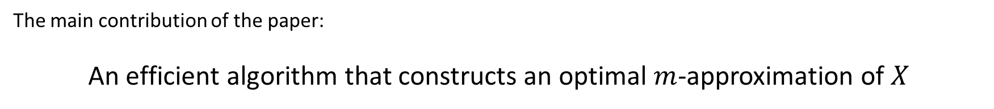
Contribution
The Kolmogorov distance between $X$ and $X′$ is: $d_{K}\left(X,X^{′}\right)=\max_{t} \left|F_{X}\left(t\right)−F_{X^{′}}\left(t\right)\right|$
A random variable $X′$ is an optimal $m$-approximation of a random variable $X$ if $\left|{supp(X}^{′})\right|≤ m$and there is no random variable $X′′$ such that $\left|{supp(X}^{′′})\right|≤m$and $d_{K}(X,X′′)< d_{K}(X,X′)$.
The main contribution of the paper:
An efficient algorithm that constructs an optimal $m$-approximation of $X$

Slide 3

Motivation
Estimation of the probability for missing deadlines
Sparse approximations (aka sparse representation) that deal with sparse solutions for systems of linear equations
Binning in statistical inference
Data and signal compression

Slide 4
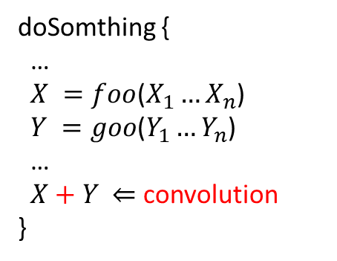
A motivating problem
Sequence
Primitive
doSomthing {
…
$X =foo$($X_{1}…X_{n}$)
$Y =goo$($Y_{1}…Y_{n}$)
…
$X+Y$ $⇐$ convolution
}
Sequence
Sequence
More generally
Primitive
Primitive
Primitive
Primitive
Computing probabilities of meeting deadline in series-parallel schedules
Handling complexities in algorithms that manipulate random variables

Slide 5
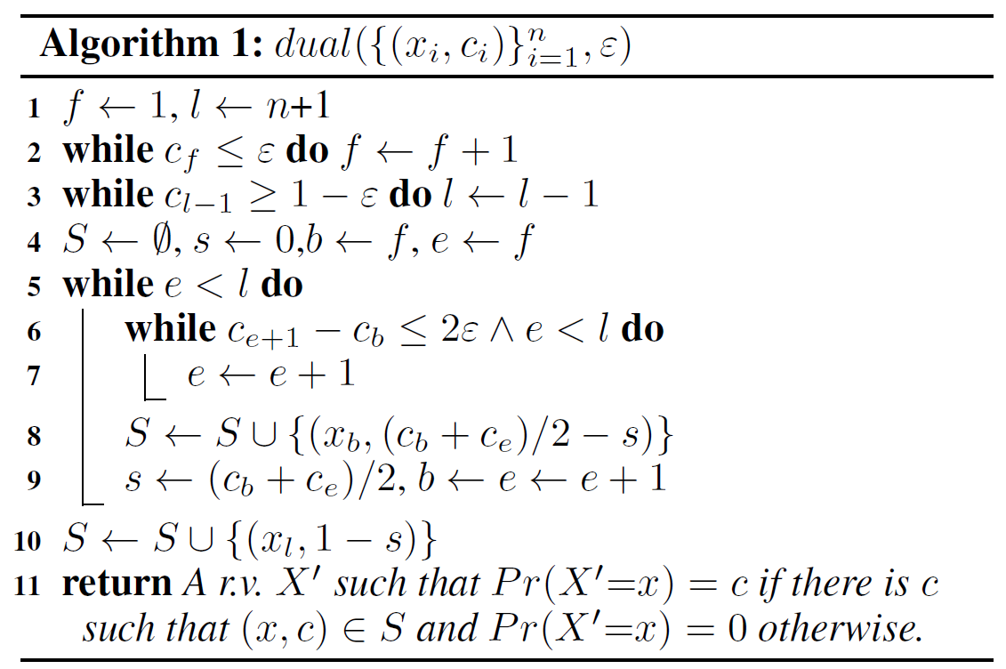
Dual algorithm
Complexity:
$dual({\left\{x_{i},c_{i}\right\}}_{i=1}^{n},ε)$runs in $O\left(n\right)$ time and memory

Slide 6



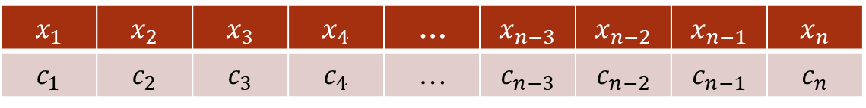
Dual algorithm – running example
$X=\{\left(x_{1},c_{1}\right),$ $\left(x_{2},c_{2}\right)$,…, $\left(x_{n−1},c_{n−1}\right)$, $\left(x_{n},c_{n}\right)\}, ε$
$$f=1, l=n+1$$
$$x_{n}$$ | $$x_{n−1}$$ | $$x_{n−2}$$ | $$x_{n−3}$$ | … | $$x_{4}$$ | $$x_{3}$$ | $$x_{2}$$ | $$x_{1}$$
$$c_{n}$$ | $$c_{n−1}$$ | $$c_{n−2}$$ | $$c_{n−3}$$ | … | $$c_{4}$$ | $$c_{3}$$ | $$c_{2}$$ | $$c_{1}$$
$$f=1$$
$$l=n+1$$

Slide 7
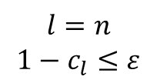
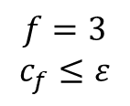
Dual algorithm – running example
$X=\{\left(x_{1},c_{1}\right),$ $\left(x_{2},c_{2}\right)$,…, $\left(x_{n−1},c_{n−1}\right)$, $\left(x_{n},c_{n}\right)\}, ε$
$$x_{n}$$ | $$x_{n−1}$$ | $$x_{n−2}$$ | $$x_{n−3}$$ | … | $$x_{4}$$ | $$x_{3}$$ | $$x_{2}$$ | $$x_{1}$$
$$c_{n}$$ | $$c_{n−1}$$ | $$c_{n−2}$$ | $$c_{n−3}$$ | … | $$c_{4}$$ | $$c_{3}$$ | $$c_{2}$$ | $$c_{1}$$
$$f=3$$
$$c_{f}≤ε$$
$$l=n$$
$${1−c}_{l}≤ε$$

Slide 8
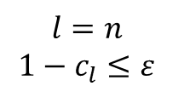
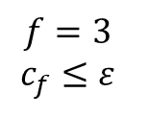

Dual algorithm – running example
$X=\{\left(x_{1},c_{1}\right),$ $\left(x_{2},c_{2}\right)$,…, $\left(x_{n−1},c_{n−1}\right)$, $\left(x_{n},c_{n}\right)\}, ε$
$$S=∅, s=0,b=3, e=3$$
$$x_{n}$$ | $$x_{n−1}$$ | $$x_{n−2}$$ | $$x_{n−3}$$ | … | $$x_{4}$$ | $$x_{3}$$ | $$x_{2}$$ | $$x_{1}$$
$$c_{n}$$ | $$c_{n−1}$$ | $$c_{n−2}$$ | $$c_{n−3}$$ | … | $$c_{4}$$ | $$c_{3}$$ | $$c_{2}$$ | $$c_{1}$$
$$f=3$$
$$c_{f}≤ε$$
$$l=n$$
$${1−c}_{l}≤ε$$

Slide 9


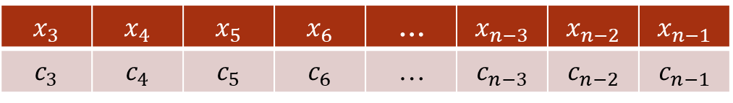
Dual algorithm – running example
$X=\{\left(x_{1},c_{1}\right),$ $\left(x_{2},c_{2}\right)$,…, $\left(x_{n−1},c_{n−1}\right)$, $\left(x_{n},c_{n}\right)\}, ε$
$$S=∅, s=0,b=3, e=3$$
$$x_{n−1}$$ | $$x_{n−2}$$ | $$x_{n−3}$$ | … | $$x_{6}$$ | $$x_{5}$$ | $$x_{4}$$ | $$x_{3}$$
$$c_{n−1}$$ | $$c_{n−2}$$ | $$c_{n−3}$$ | … | $$c_{6}$$ | $$c_{5}$$ | $$c_{4}$$ | $$c_{3}$$
$$b=e=f=3$$
$$l=n$$

Slide 10
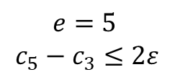

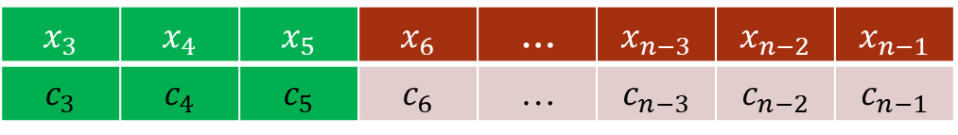
Dual algorithm – running example
$X=\{\left(x_{1},c_{1}\right),$ $\left(x_{2},c_{2}\right)$,…, $\left(x_{n−1},c_{n−1}\right)$, $\left(x_{n},c_{n}\right)\}, ε$
$$S=∅, s=0,b=3, e=3$$
$$x_{n−1}$$ | $$x_{n−2}$$ | $$x_{n−3}$$ | … | $$x_{6}$$ | $$x_{5}$$ | $$x_{4}$$ | $$x_{3}$$
$$c_{n−1}$$ | $$c_{n−2}$$ | $$c_{n−3}$$ | … | $$c_{6}$$ | $$c_{5}$$ | $$c_{4}$$ | $$c_{3}$$
$$b=3$$
$$e=5$$
$$c_{5}−c_{3}≤2ε$$
$$l=n$$

Slide 11

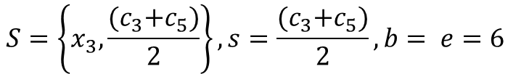
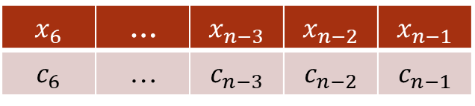
Dual algorithm – running example
$X=\{\left(x_{1},c_{1}\right),$ $\left(x_{2},c_{2}\right)$,…, $\left(x_{n−1},c_{n−1}\right)$, $\left(x_{n},c_{n}\right)\}, ε$
$$S=\left\{x_{3},\frac{{(c}_{3}+c_{5})}{2}\right\}, s=\frac{{(c}_{3}+c_{5})}{2},b= e=6$$
$$x_{n−1}$$ | $$x_{n−2}$$ | $$x_{n−3}$$ | … | $$x_{6}$$
$$c_{n−1}$$ | $$c_{n−2}$$ | $$c_{n−3}$$ | … | $$c_{6}$$
$$b=e=6$$
$$l=n$$

Slide 12
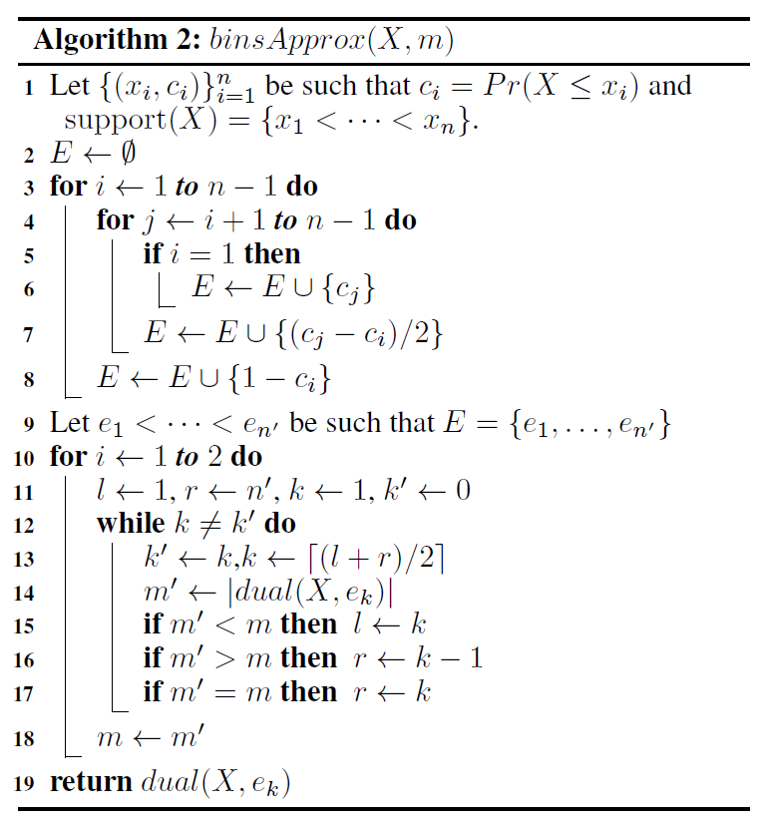
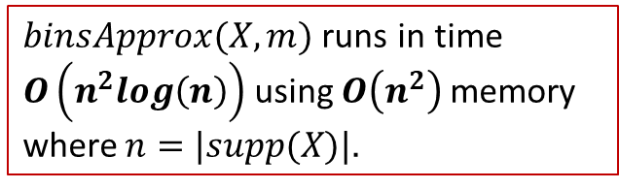
Binary Search Approximation
Complexity:
$binsApprox(X,m)$runs in time $O\left(n^{2}log\left(n\right)\right)$ using $O\left(n^{2}\right)$memory where $n=|supp(X)|$.

Slide 13

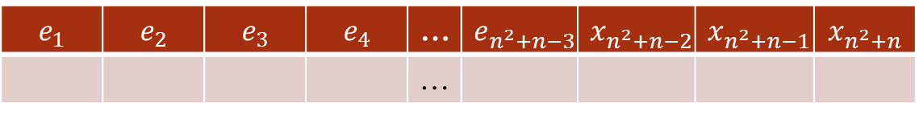
Binary approx. algorithm – running example
$X=\{\left(x_{1},c_{1}\right),$ $\left(x_{2},c_{2}\right)$,…, $\left(x_{n−1},c_{n−1}\right)$, $\left(x_{n},c_{n}\right)\}, m$
$$E=e_{1}… e_{n^{2}+n} (note:{n^{′}= n}^{2}+n)$$
$$x_{n^{2}+n}$$ | $$x_{n^{2}+n−1}$$ | $$x_{n^{2}+n−2}$$ | $$e_{n^{2}+n−3}$$ | … | $$e_{4}$$ | $$e_{3}$$ | $$e_{2}$$ | $$e_{1}$$
 |  |  |  | …

Slide 14

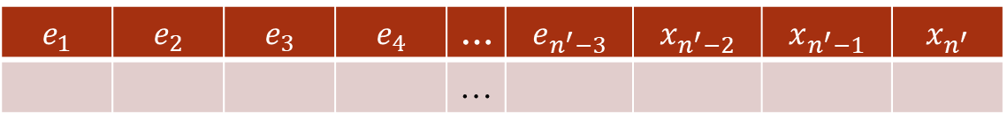
Binary approx. algorithm – running example
$X=\{\left(x_{1},c_{1}\right),$ $\left(x_{2},c_{2}\right)$,…, $\left(x_{n−1},c_{n−1}\right)$, $\left(x_{n},c_{n}\right)\}, m$
$$E=e_{1}… e_{n^{2}+n} (note:{n^{′}= n}^{2}+n)$$
$$x_{n^{′}}$$ | $$x_{n^{′}−1}$$ | $$x_{n^{′}−2}$$ | $$e_{n^{′}−3}$$ | … | $$e_{4}$$ | $$e_{3}$$ | $$e_{2}$$ | $$e_{1}$$
 |  |  |  | …
$$\frac{l+r}{2}$$

Slide 15


Binary approx. algorithm – running example
$X=\{\left(x_{1},c_{1}\right),$ $\left(x_{2},c_{2}\right)$,…, $\left(x_{n−1},c_{n−1}\right)$, $\left(x_{n},c_{n}\right)\}, m$
$$E=e_{1}…e_{n^{′}}, k=\frac{l+r}{2}$$
$$x_{n^{′}}$$ | $$x_{n^{′}−1}$$ | $$x_{n^{′}−2}$$ | $$e_{n^{′}−3}$$ | … | $$e_{4}$$ | $$e_{3}$$ | $$e_{2}$$ | $$e_{1}$$
 |  |  |  | …
$$dual(X,e_{4})$$
$$\frac{l+r}{2}$$

Slide 16
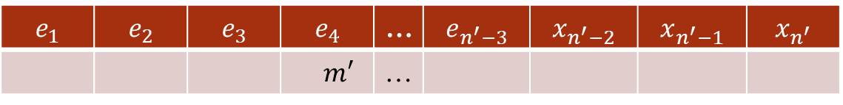
Binary approx. algorithm – running example
$X=\{\left(x_{1},c_{1}\right),$ $\left(x_{2},c_{2}\right)$,…, $\left(x_{n−1},c_{n−1}\right)$, $\left(x_{n},c_{n}\right)\}, m$
$$E=e_{1}…e_{n^{′}}, k=\frac{l+r}{2}$$
$$x_{n^{′}}$$ | $$x_{n^{′}−1}$$ | $$x_{n^{′}−2}$$ | $$e_{n^{′}−3}$$ | … | $$e_{4}$$ | $$e_{3}$$ | $$e_{2}$$ | $$e_{1}$$
 |  |  |  | … | $$m′$$
$$\frac{l+r}{2}$$

Slide 17

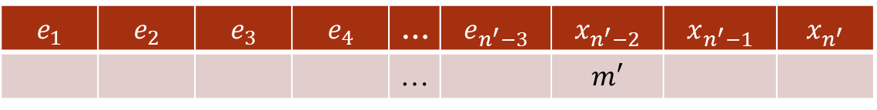
Binary approx. algorithm – running example
$X=\{\left(x_{1},c_{1}\right),$ $\left(x_{2},c_{2}\right)$,…, $\left(x_{n−1},c_{n−1}\right)$, $\left(x_{n},c_{n}\right)\}, m$
$$E=e_{1}…e_{n^{′}}, k=\frac{l+r}{2}$$
$$x_{n^{′}}$$ | $$x_{n^{′}−1}$$ | $$x_{n^{′}−2}$$ | $$e_{n^{′}−3}$$ | … | $$e_{4}$$ | $$e_{3}$$ | $$e_{2}$$ | $$e_{1}$$
 |  | $$m′$$ |  | …
$$\frac{k+r}{2}$$

Slide 18

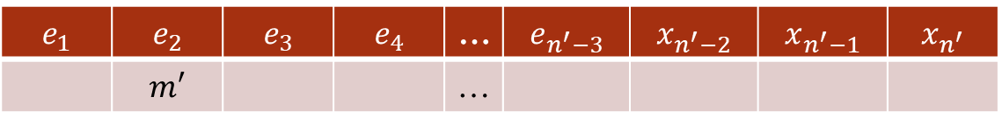
Binary search approx. – running example
$X=\{\left(x_{1},c_{1}\right),$ $\left(x_{2},c_{2}\right)$,…, $\left(x_{n−1},c_{n−1}\right)$, $\left(x_{n},c_{n}\right)\}, m$
$$E=e_{1}…e_{n^{′}}, k=\frac{l+r}{2}$$
$$x_{n^{′}}$$ | $$x_{n^{′}−1}$$ | $$x_{n^{′}−2}$$ | $$e_{n^{′}−3}$$ | … | $$e_{4}$$ | $$e_{3}$$ | $$e_{2}$$ | $$e_{1}$$
 |  |  |  | … |  |  | $$m′$$
$$\frac{k−1+r}{2}$$

Slide 19
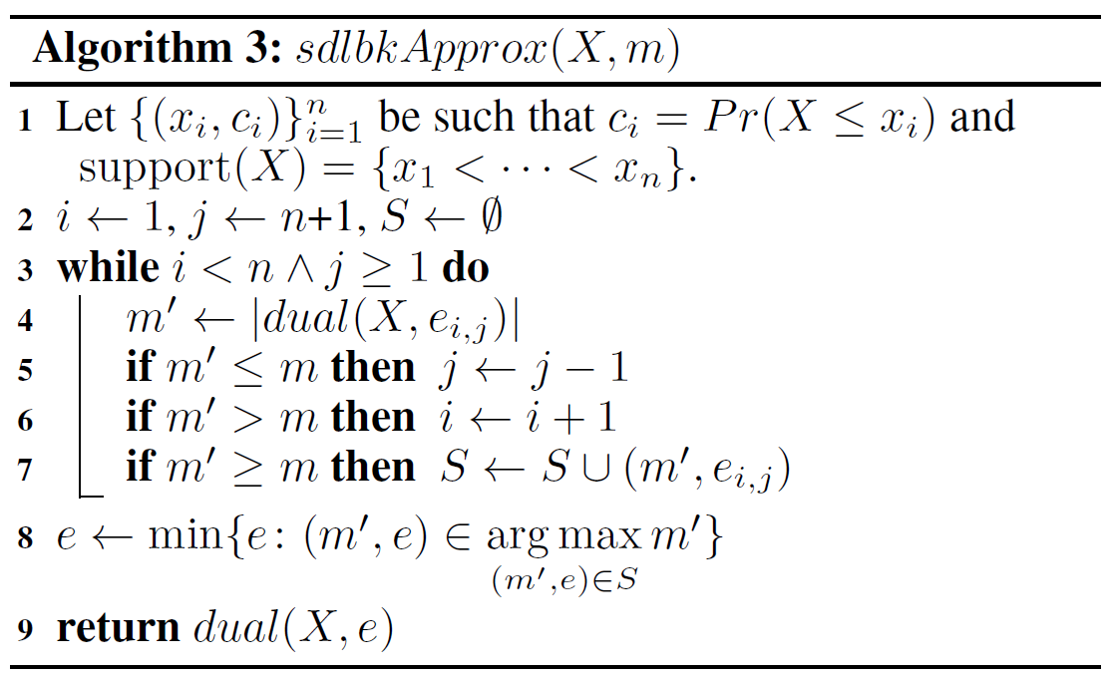
Saddleback Approximation
$sdlbkApprox(X,m)$runs in time $O(n^{2}log\left(n\right))$, using $O(n^{2})$memory where $n=\left|supp\left(X\right)\right|$.

Slide 20
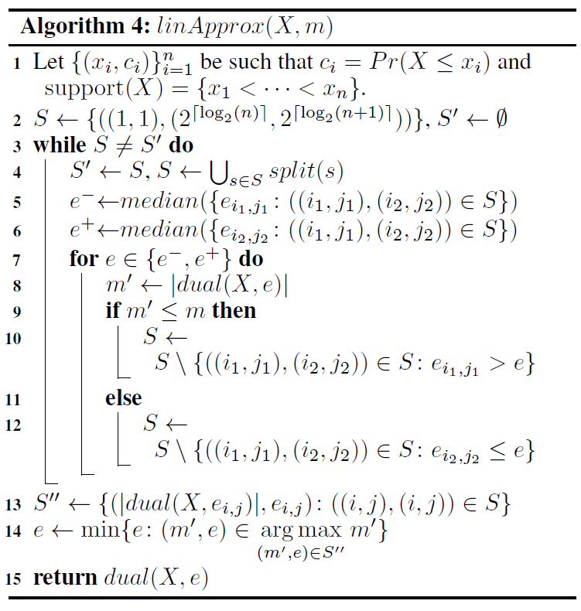
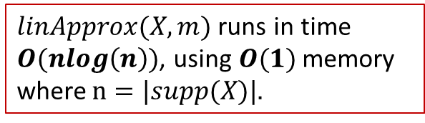
Linear Approximation
$linApprox(X,m)$runs in time $O(nlog\left(n\right))$, using $O(1)$memory where $n=|supp(X)|$.

